Slide 1
HTML
Introduction

Slide 2
Agenda
History
HTML versions
Definition and Purpose
XHTML
HTML structure
Other Related Concepts
HTML Elements
HTML5

Slide 3
What’s HTML?
HyperText Markup Language is the standard markup language used to create web pages
Its written in form of HTML elements
The purpose of the Web Browser is to read HTML documents

Slide 4
cont ...
Development its on going
Describes the structure of a website semantically along with hints of presentation
It's a markup instead of a programming language

Slide 5
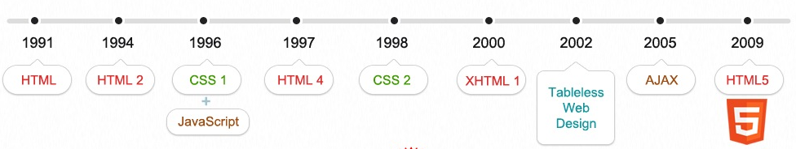
HTML history

Slide 6
HTML elements structure
<tag attribute1=”value” attribute2=”...”>
innerHTML
</tag>

Slide 7
HTML elements
Are the building blocks of HTML
Are keywords surrounded by angle brackets
Can represent text, input fields, style, page properties, images, objects, links, headings.
HTML elements = HTML tags (usually), strictly speaking, an HTML element is everything between the start and the end of the HTML tag, including the tags

Slide 8
HTML elements structure rules
Elements should have open and close tags
Tags can have more than one property (attribute)
There are some predefined attributes for each different tag type. ie: href, src
HTML elements can be nested in other elements

Slide 9
...
Element content is everything between the open and close tag.
Some HTML elements has no content, ie: <br />, <hr />
Most HTML elements can be nested (contain others HTML elements in their content)
Tags are not case sensitive (XHTML requires lowercase)

Slide 10
Global and Event Attributes
Common set of attributes shared by all the HTML elements:
Global: id, class, style, title, lang, dir, accesskey
Events: onload, onunload, onblur, onchange, onclick, onsubmit, etc.
Are common to subgroups of HTML elements, for example form elements share form events.

Slide 11
Workshop Time

Slide 12
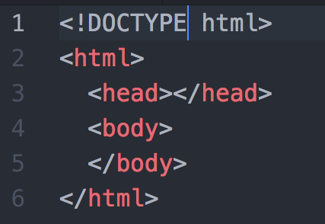
HTML structure

Slide 13
XHTML vs HTML
Extensible HyperText Markup Language (XHTML) is a family of XML markup languages that mirror or extend versions of the widely used Hypertext Markup Language (HTML)
Born in year 2000
Its main purpose was to split structure from design on an HTML document and to create some sort of constraints in an attempt for HTML code standardization

Slide 14
XHTML
Is stricter than HTML (a lot of bad code)
Is HTML defined as an XML application
Is supported by all major browsers
Behavior differences
Parse XML error causes document processing to be aborted
All CSS selectors become case-sensitive

Slide 15
cont..
Syntax differences:
each element should have a closing tag.
is case-sensitive for elements and attributes names
attribute minimization it’s not permitted, so all property's values should be enclosed with quotes (“)

Slide 16
Recommendations
Always enclose attributes values with “
Always use lower-case, W3C recommends it and XHTML requires it.
When opening tag, make sure to create its corresponding closing one.
Each tag has a reason to exist, use them accordingly.

Slide 17
More fundamentals
URLs, paths, other tags

Slide 18
URL
Uniform Resource Locator
Requests are done by referencing an URL
Theoretically: is unique in the World
Structure:
scheme://subdomain.domain.tld:port/uri
Some common schemes:
http, https, ftp

Slide 19
Relative vs Absolute URLs
Assuming the following Folder Structure:
mysite.com/index.html
mysite.com/test.html
mysite.com/examples/
mysite.com/examples/index.html
mysite.com/examples/one.html

Slide 20
Relative vs Absolute URLs
Browser URL: http://mysite.com/
Type | Anchor element | Resulting URL
Absolute | <a href=”http://mysite.com/test.html”> Test </a> | http://mysite.com/test.html
Relative | <a href=”test.html”> Test </a> | http://mysite.com/test.html
Browser URL: http://mysite.com/examples/
Type | Anchor element | Resulting URL
Absolute | <a href=”http://mysite.com/test.html”> Test </a> | http://mysite.com/test.html
Relative | <a href=”test.html”> Test </a> | http://mysite.com/examples/test.html

Slide 21
Root Relative
Browser URL: http://mysite.com/
Type | Anchor element | Resulting URL
Absolute | <a href=”http://mysite.com/test.html”> Test </a> | http://mysite.com/test.html
Relative | <a href=”/test.html”> Test </a> | http://mysite.com/test.html
Browser URL: http://mysite.com/examples/
Type | Anchor element | Resulting URL
Absolute | <a href=”http://mysite.com/test.html”> Test </a> | http://mysite.com/test.html
Relative | <a href=”/test.html”> Test </a> | http://mysite.com/test.html

Slide 22
Virtual vs Physical path
Virtual → /example/1.html
Physical
Windows → C:\Site\test.com\example\1.html
Unix → /var/www/test.com/example/1.html
Note: Add a trailing slash to subfolder references, ie: http://goto.com/test/, reduces from 2 to 1 requests to the server

Slide 23
HTML Elements

Slide 24
Common HTML Elements
Comments → <!-- comment here -->
Doctype → it's optional in some cases, it defaults to HTML5, but it's recommended to include it
Required Elements → html, body, head
Headings → h1 to h6
Text Related → p, span, pre, br, b, i, strong, italic, ul, ol, li,
Wrappers → div, fieldset, table
Media → iframe, img, a, form
Form → input, button, label, textarea, select

Slide 25
Not common but important elements
<head> tag has:
<title> → Page title, very important for SEO
<base> → All relative url will use this as base
ie: <base href=”http://google.com/” />
<style> → Add CSS to the document
<meta> → Meta tags (keywords), important for SEO
<meta content="http://www.google.com/logos/doodles/2015/first-day-of-fall-2015-northern-hemisphere-6003706315145216-thp.png" property="og:image">
<link> → links the HTML with external document
<link rel="stylesheet" type="text/css" href="mystyle.css">

Slide 26
HTML special details
entities, encoding, conditional comments, bookmarks

Slide 27
HTML bookmarks
Add an id attribute to an anchor element:
<a id="tips">Useful Tips Section</a>
Create link to that section on the same doc
<a href="#tips">Visit the Useful Tips Section</a>
An external link
<a href="http://goto.com/html_links.htm#tips">
Visit the Useful Tips Section</a>

Slide 28
Conditional Comments
Available only for IE (ver 10 and below only)
Identifies a portion of HTML to be created if condition matches.
Examples:
<![if lt IE 8]> <p>Please upgrade to Internet Explorer version 8.</p> <![endif]>
<!--[if IE 8]> <p>Welcome to Internet Explorer 8.</p> <![endif]-->

Slide 29
HTML entities
Reserved and special characters could be represented as an HTML entity.
Entities format: &entity_name; or &#entity_number;
When to use them:
Lets say you want to put this text in a p: “X < Y”
At your HTML you try: <p> X < y </p> (see the issue?)
You will convert that to: <p> X &lt; Y </p> using entities.

Slide 30
Encoding (Character Encoding)
ASCII, first character encoding. 127 different alphanumeric characters that could be used on the internet.
Supported numbers (0-9),letters (A-Z), and some special characters like ! $ + - ( ) @ < > .
ANSI (Windows-1252) was the default character set for Windows (up to Windows 95). It supported 256 different codes.

Slide 31
...
ISO-8859-1, (extension to ASCII), was the default character set for HTML 4. It also supported 256 different codes.
Because ANSI and ISO was too limited, the default character encoding was changed to Unicode (UTF-8) in HTML5.
Unicode covers (almost) all the characters and symbols in the world.

Slide 32
Charset tag
To determine the charset of the doc:
HTML 4
<meta http-equiv="Content-Type" content="text/html;charset=ISO-8859-1">
HTML 5
<meta charset="UTF-8">

Slide 33
Forms
html elements, HTTP verbs

Slide 34
HTML elements
form attributes
action: defines which url will receive the request upon submission
method: defines the HTTP verb to submit on the request, values (post or get)
form, input(text,password,submit, reset, radio, checkbox, hidden, email, phone), select, label, textarea, button,

Slide 35
HTTP Verbs
Existent verbs: PUT, POST, GET, DELETE, PATCH, HEAD
Most common in forms: GET or POST
POST
Data is included in the body of the request
Not “visible” to users
GET
Data is included in the query string (URL)
Has a max limit

Slide 36


Slide 37
More Global Attributes
data-*
draggable
contextmenu
dropzone
hidden
spellcheck
translate
contenteditable

Slide 38
New HTML elements
Semantic tags like: header, footer, section, article.
New Input types: number, date, time, calendar, range
New graphic elements: <canvas>, svg
Multimedia elements: <audio>, video

Slide 39
New HTML APIs
Localstorage, SessionStorage
Drag and Drop
Geolocation
Web Workers
App Cache
Server Side Events

